Slide 1
Multimedia System and Virtual Environment
CSE – 310
Multimedia Networks
Dept. of Computer Science and Engineering, University of Rajshahi

Slide 2
Multimedia Networks
Lecture 15
Outline
Multimedia Traffic Characterization
Quality of Service
Quality of Service Parameter
Quality of Service Classes
Multicasting
Internet Group Management Protocol
Multicast Backbone (MBone)
Dept. of Computer Science and Engineering, University of Rajshahi

Slide 3
Multimedia Networks
Lecture 15
Multimedia Traffic Characterization
Multimedia data are known as continuous data and have the following characteristics:
Voluminous: They demand high data rates.
Real-Time and Interactive: They demand low delay and synchronization between audio and video for “lip sync”.
Sometimes Bursty: Data rate fluctuate drastically.
Dept. of Computer Science and Engineering, University of Rajshahi

Slide 4
Multimedia Networks
Lecture 15
Quality of Service
Provide guarantees on the ability of a network to deliver predictable results.
Elements of network performance within the scope of QoS often include availability (uptime), bandwidth (throughput), latency (delay), and error rate.
Multimedia Traffic Parameters
peak arrival rate of the multimedia data when the source is in the active state(peak rate);
average data unit arrival rate;
burstiness: ratio between the peak data rate and the average data rate;
average duration of the active state.
Dept. of Computer Science and Engineering, University of Rajshahi

Slide 5
Multimedia Networks
Lecture 15
Quality of Service Parameter
Data Rate
Latency
Packet loss or error
Jitter
Sync skew
Dept. of Computer Science and Engineering, University of Rajshahi

Slide 6
Multimedia Networks
Lecture 15
Perceived QoS
QoS itself is a collective effect of service performances that has everything to do with how the user perceives it.
In real time multimedia, regularity is more important than latency.
Temporal correctness is more important than the sound and picture quality.
Humans tend to focus on one subject at a time.
Dept. of Computer Science and Engineering, University of Rajshahi

Slide 7
Multimedia Networks
Lecture 15
QoS Classes
Guaranteed Service Class
QoS guarantees are provided based on deterministic and statistical QoS parameters
Predictive Service Class
QoS parameter values are estimated and based on the past behavior of the service
Best Effort Service Class
There are no guarantees or only partial guarantees are provided
Dept. of Computer Science and Engineering, University of Rajshahi

Slide 8
Multimedia Networks
Lecture 15
Best Effort vs. QoS
Guaranteed QoS
We need to provide 100% guarantees for QoS values (hard) or very close to 100% (soft)
Advantages: QoS guarantees are satisfied even in the worst case.
Disadvantage: Over-reservation of resources, hence needless rejection of requests
Best Effort QoS
No QoS bounds or possible very weak QoS bounds
Advantages: resource capacities can be statistically multiplexed, hence more processing requests can be granted
Disadvantages: QoS may be temporally violated
Dept. of Computer Science and Engineering, University of Rajshahi

Slide 9
Multimedia Networks
Lecture 15
Unicast Routing
Unicast: In unicasting, the router forwards the received datagram through only one of its interfaces.
Dept. of Computer Science and Engineering, University of Rajshahi

Slide 10
Multimedia Networks
Lecture 15
Multicast Routing
Multicast: In multicasting, the router may forward the received datagram through several of its interfaces.
Dept. of Computer Science and Engineering, University of Rajshahi

Slide 11
Multimedia Networks
Lecture 15
Multicasting Applications
Broadcast audio/video
Push-based systems
Software distribution
Web-cache updates
Teleconferencing (audio, video, shared whiteboard, text editor)
Multi-player games
Server/service location
Other distributed applications
Dept. of Computer Science and Engineering, University of Rajshahi

Slide 12
Multimedia Networks
Lecture 15
Multicasting cont.
Emulation of multicasting through multiple unicasting is not efficient and may create long delays, particularly with a large group.
Dept. of Computer Science and Engineering, University of Rajshahi

Slide 13
Multimedia Networks
Lecture 15
Internet Group Management Protocol
Multicast communication means that a sender sends a message to a group of recipients that are members of the same group.
Each multicast router needs to know the list of groups that have at least one loyal member related to each interface.
Collection of this type of information is done at two levels: locally and globally. The first task is done by the IGMP protocol; the second task is done by the multicast routing protocols.
Dept. of Computer Science and Engineering, University of Rajshahi

Slide 14
Multimedia Networks
Lecture 15
IGMP
End system to router protocol is IGMP
Each host keeps track of which multicast groups are subscribed to
Objective is to keep router up-to-date with group membership of entire LAN
Routers need not know who all the members are, only that members exist
Dept. of Computer Science and Engineering, University of Rajshahi

Slide 15
Multimedia Networks
Lecture 15
How IGMP Works
Routers:
Q
Hosts:
On each link, one router is elected the “querier”
Querier periodically sends a Membership Query message to the all-systems group, with TTL = 1 ()
On receipt, hosts start random timers (between 0 and 10 seconds) for each multicast group to which they belong
Dept. of Computer Science and Engineering, University of Rajshahi

Slide 16
Multimedia Networks
Lecture 15
How IGMP Works (cont.)
Routers:
Q
Hosts:
G
G
G
G
When a host’s timer for group G expires, it sends a Membership Report to group G, with TTL = 1
Other members of G hear the report and stop their timers
Routers hear all reports, and time out non-responding groups
Dept. of Computer Science and Engineering, University of Rajshahi

Slide 17
Multimedia Networks
Lecture 15
How IGMP Works (cont.)
Note that, in normal case, only one report message per group present is sent in response to a query
Query interval is typically 60-90 seconds
When a host first joins a group, it sends one or two immediate reports, instead of waiting for a query
Dept. of Computer Science and Engineering, University of Rajshahi

Slide 18
Multimedia Networks
Lecture 15
Multicast Backbone (MBone)
Multimedia and real-time communication have increased the need for multicasting in the Internet.
However, only a small fraction of Internet routers are multicast routers.
This problem may be solved by adding more and more multicast routers.
Another solution is tunneling.
The multicast routers are seen as a group of routers on top of unicast routers.
The multicast routers may not be connected directly, but they are connected logically.
Dept. of Computer Science and Engineering, University of Rajshahi

Slide 19
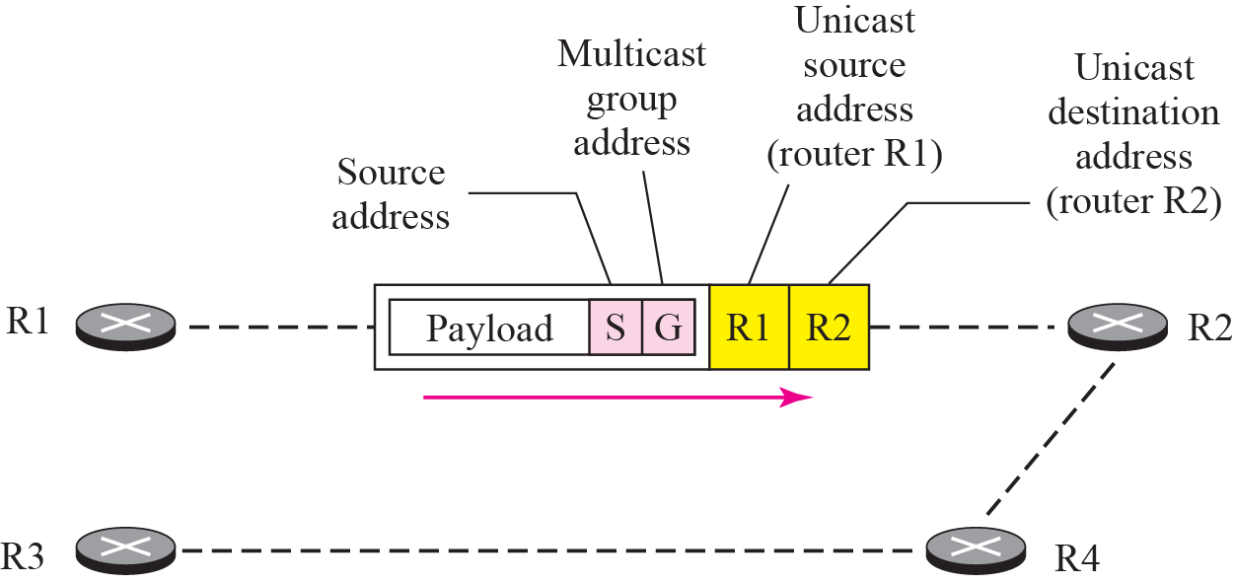
Multimedia Networks
Lecture 15
MBone Tunnels
A method for sending multicast packets through multicast-ignorant routers
IP multicast packet is encapsulated in a unicast packet addressed to far end of tunnel:
Dept. of Computer Science and Engineering, University of Rajshahi

Slide 20
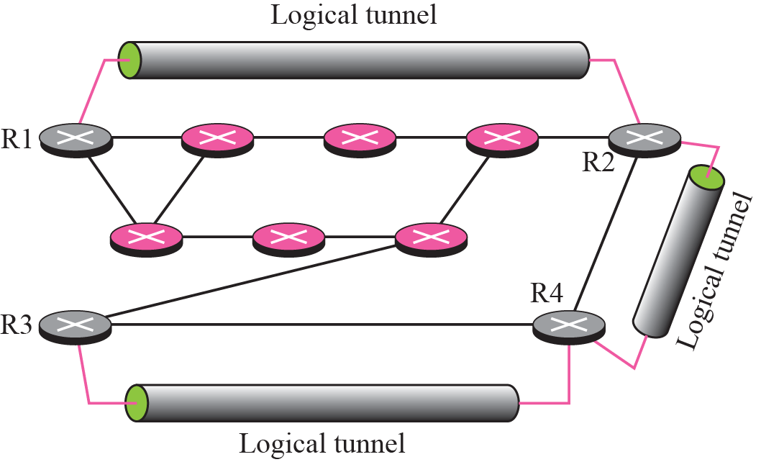
Multimedia Networks
Lecture 15
MBone Tunnels
Tunnel acts like a virtual point-to-point link
Each end of tunnel is manually configured with unicast address of the other end
Dept. of Computer Science and Engineering, University of Rajshahi

Slide 21
Multimedia Networks
Lecture 15
Time-to-live (TTL) is a value in an Internet Protocol (IP) packet that tells a network router whether or not the packet has been in the network too long and should be discarded.
Dept. of Computer Science and Engineering, University of Rajshahi

